Slide 1



PROJECT ON
DEFENCE IN DEPTH

Slide 2
Project Overview
Applying the concept of Defence in Depth, we have demonstrated a vulnerable login website connected with a database in a network
We have tried to implement security concepts like DMZ, IDS-IPS, Proxy, Firewalls, Digital certificates at each layer inside our own network created with the help of a wireless-router.
To demonstrate layered security in our network, we have used various tools like Iptables, Nagios, Snort, Apache2, MySQL, Nginx, DNS, XCA and a wireless-router.
We have tested our login website against some of the most common cyber-attacks like SQL Injection, Cross-Site Scripting, Brute Force, Dictionary Attacks and Session Hijacking with the help of Burp-suite and ZAP tool.

Slide 3
Further more Overview.
Thus, we have tried to implement and learn many different key concepts that we have studied in our course and bring them together to emulate an infrastructure
We have managed our project by deploying SCRUM FRAMEWORK and tried to showcase how Information Security can be achieved in a network.

Slide 4
My Role in this Project
In Project I Configuring IPSEC Protocol using Strong swan Package On Both The Machines
On machine 1—I configure Ip sec Using /etc/ipsec.conf file
Here I setup a vpn tunnel by specifying the left subnet and right subnet and the respective both machine ip address..
after that I also use a scret key to encrypt the packet travelling via vpn tunnel. Using ipsec.secrets file.
here I also setup a keylife time for its validity after that the key will expire.
The protocol I use in Configuring .—is IKEv called as Internet key exchange Version. That use to setup a securre authenticated communication channel between two parties over a network.

Slide 5
My Role
Apart From that I also created a Web site Using Html and css For vulnerable detection and help in the documentation and report generation process as well.

Slide 6
What I learn From This Project
The understanding of Network Security Protocols
Key exchange protocol how keys are exchange.
Learn to analyze logs and status outputs to troubleshoot issues with IPsec connections.
Understand how to configure firewalls to allow IPsec traffic (e.g., UDP ports 500 and 4500).

Slide 7


Computing Components
1 Kali Linux Machine- Database
IPSec Concept for creating vpn tunnel
Nginx Apache2 server
2 Debian Machine

Slide 8
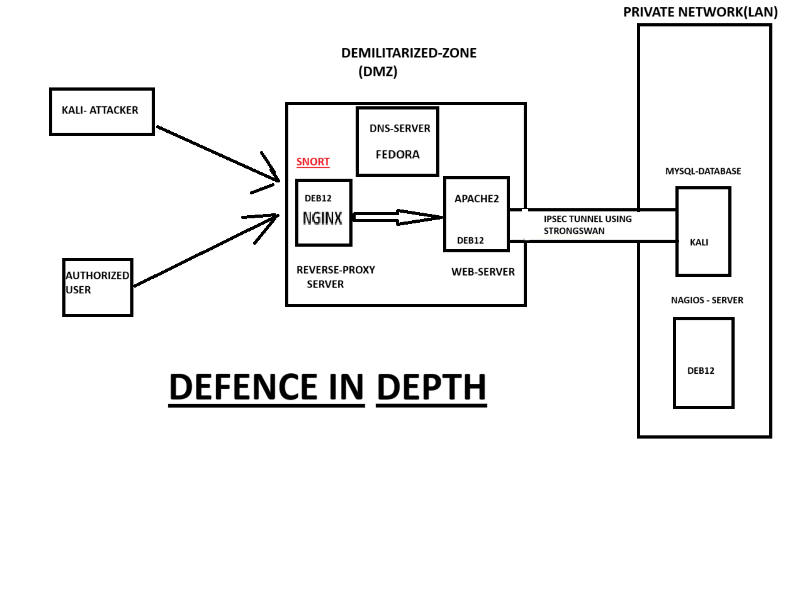
Architecture

Slide 9

Thankyou Presented by- Kshitij Shrivastava
PG-DITISS MARCH @2024 batch
Roll Number –83925
Prn-240344223016

